Slide 1
IMAGE PROCESSING
WEEK-1

Slide 2
5. NN to classify image

Slide 3
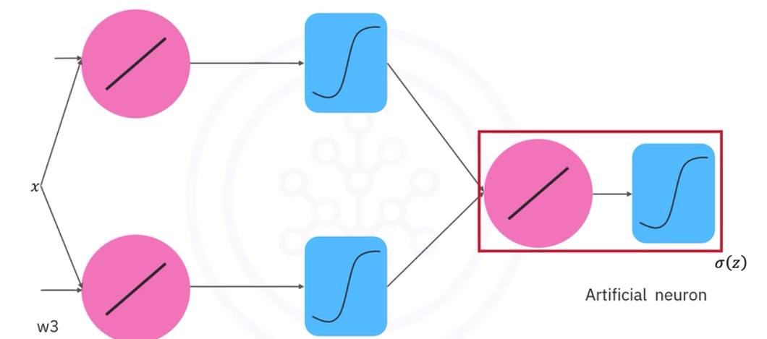
Neural network basics:
A neural network is a computational model inspired by human brain.
It is used for separating non-linearly separable data.
The work of neural network is to approximate the class by using learnable parameter.
In this diagram it represents a two-layer neural network, We have the hidden layer.
Each linear function and activation function is known as an artificial neuron.
In this figure the hidden layer has two artificial neurons.
The output layer has one artificial neurons

Slide 4
Fully connected Neural network architecture :
Fully connected neural network architecture deals with how to arrange the different number of hidden layers and neurons.
In the neural network if we have more than one hidden layers that is called a deep neural network.
But neurons, or more layers may lead to overfitting.
The output layer uses activation function .Each neuron is a linear classifier
To learn parameters we have to perform gradient descent , but deeper the network gets the smaller the gradient gets.This is called vanishing gradient problem
Neural network are trained in a similar manner to logistic regression and softmax
Sigmoid activation function suffers from vanishing gradient problem but ReLU solve the vanishing gradient problem.

Slide 5
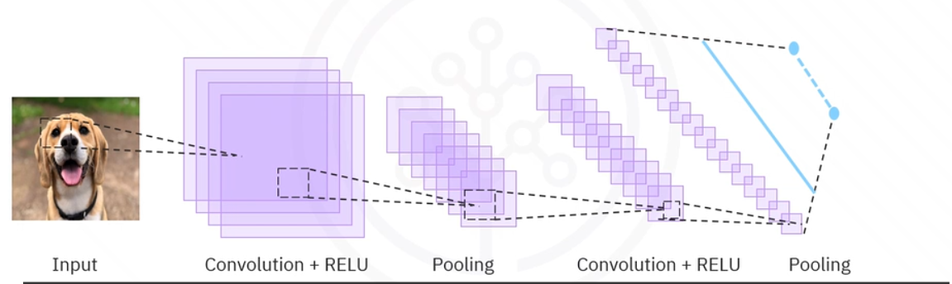
What is CNN?
A convolutional network or CNN is a neural network with special layers.
The model classifies an image by taking a part of the image . Each input image will pass through series of convolutional lakers with filter ,pooling layers,fully connected layers and while applying activation functions to classify an object
Convolution and pooling layers are the first layers used to extract features from input.
Each kernel or filter of Convolution will detect different property of the image.
Receptive field id the size of the region in the input that produces a pixel value in av.

Slide 6
Why CNN?
CNN’s are used as they understand an image just an human brain does.
Characteristics:
They captures spatial features : as cnn use convolutions(filters) to capture the local patterns automatically.
Automatic feature extraction : Traditional ML were required to use : HOG,SIFT,SURF,LBP but CNN learned to extract features automatically, and no manual feature engineering needed.
Parameter sharing : as a 3X3 filter slides is used across the whole image , this reduces the no of parameters as 3X3 filter only requires 9 parameters . This makes CNN faster, cheaper.
Translation invariance : if in an image an object is slightly moved , a normal nn will fail but a CNN will still recognizes it as the filters detects features
Work extremely well in real-world vision tasks : is used for real-world application as it outperforms classical ML by a huge margin
Hierarchy of feature feature learning : CNN learns and extracts features from simple to complex as hierarchy.
Efficient with images,videos,audio : CNN works well with grid-like data.

Slide 7
Convolutional -> filter :
Filter : a filter also known as kernel is a small matrix of numbers of dimensions usually : 3X3 , 5X5 , 7X7
Convolution is the sliding of the filter over the image and multiplying pixel values and output is called feature map.
In CNN we use convolution for detecting patterns like:
Edge
Corners
Texture
Color change
Curve
Shape part
Different filter learn different features.
In classical computer vision, human designed filters but in CNN filters automatically learns values

Slide 8
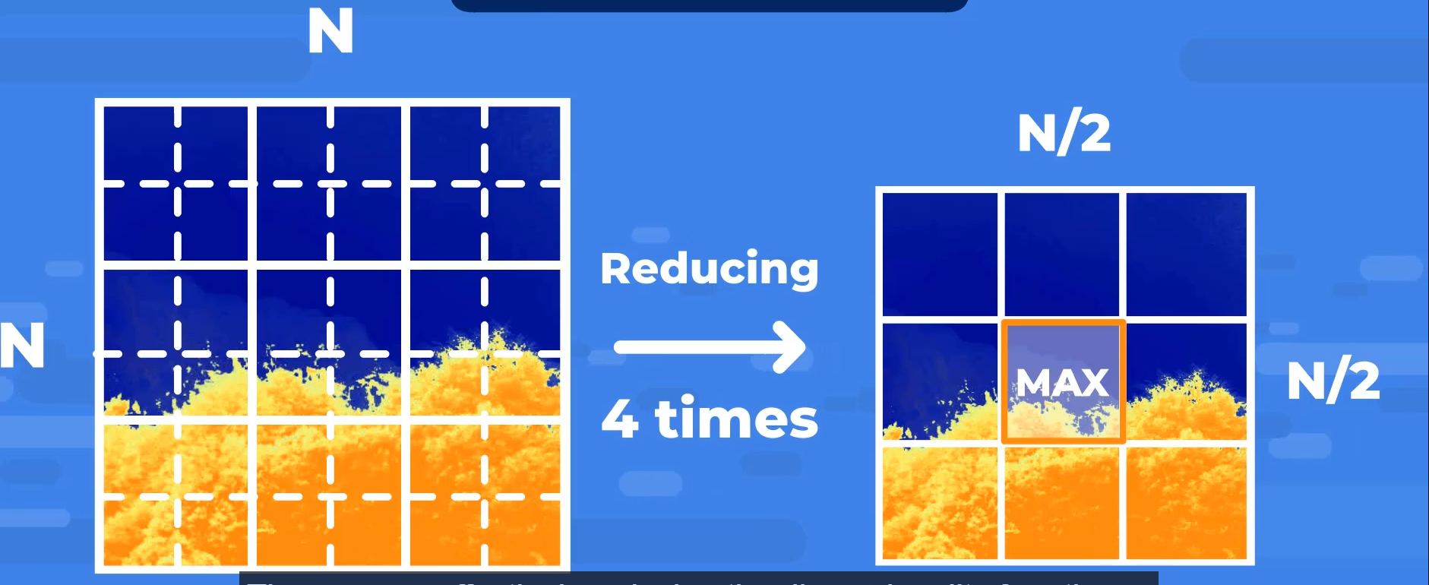
Max pooling :
Max pooling is an downsampling operation used in CNN.
It helps in :
Reduces image size
Reduce computation
Keep important features
Make the network more robust
Most commonly we use 2X2 max pooling with stride 2
In max-pooling we select the maximum number from the selected matrix

Slide 9

Activation functions :
An activation function decides whether a neuron is activated or not.
It helps in introducing non-linearity.
Without activation function becomes a neural network becomes just a linear equation
Common activation functions:
ReLU(rectified linear unit):
ReLU is commonly used in modern neural network and especially in CNN
Formulae:
It works by : if input is positive then it return the input but if its is negative or zero it returns 0.
It helps in removing negative values and helps in avoiding vanishing gradient
Drawback : dying ReLU problem : sometimes neurons get stuck and always return 0 as output
Relu is not used at the output layer.

Slide 10

Softmax:
Softmax function is an activation function used in the output layer of multi-class classification problems.
Network normally outputs number and not probllaties , to arrange the output in the range of 0 - 1 such that sum = 1
Formulae :
Input is converted into probabilities .
Used in Multi-class classification.

Slide 11
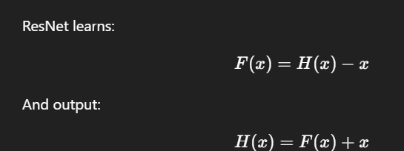
Architecture Overview(VGG,ResNet) :
VGG architecture(VGG16/VGG19) :
Stands for visual geometry group created by oxford VGG in 2014.
To shows the deep networks with small filters (3X3) improves accuracy.
Key components :
A. uses only 3X3 convolutions : kernel size->3x3 , stride = 1,easy to stack
B. Uses max-pooling : reduces spatial size and keeps depth
C. Depth : VGG16 ->16 layers , VGG19 -> 19 layers
Drawbacks : very heavy(138 parameters) , slow to train , large memory usage
ResNet :
Stands for Residual networks introduced by microsoft in 2015.
It is used for solving the vanishing gradient problem when CNN becomes very deep
This network skips a layer if not needed
Helps in preventing vanishing gradients ,
Degradation in accuracy and hard optimization.

Slide 12
POC:
Training miniature CNN model for cats and dogs classification
https://colab.research.google.com/drive/10dxQFzejMrkO_1PspD09JPS959bQMmLs#scrollTo=K0qeIqFe57wH

